Slide 1
What is JAVA?
Why JAVA is so popular?
JDK vs JRE vs JVM
What is Object Oriented Programming

Slide 2
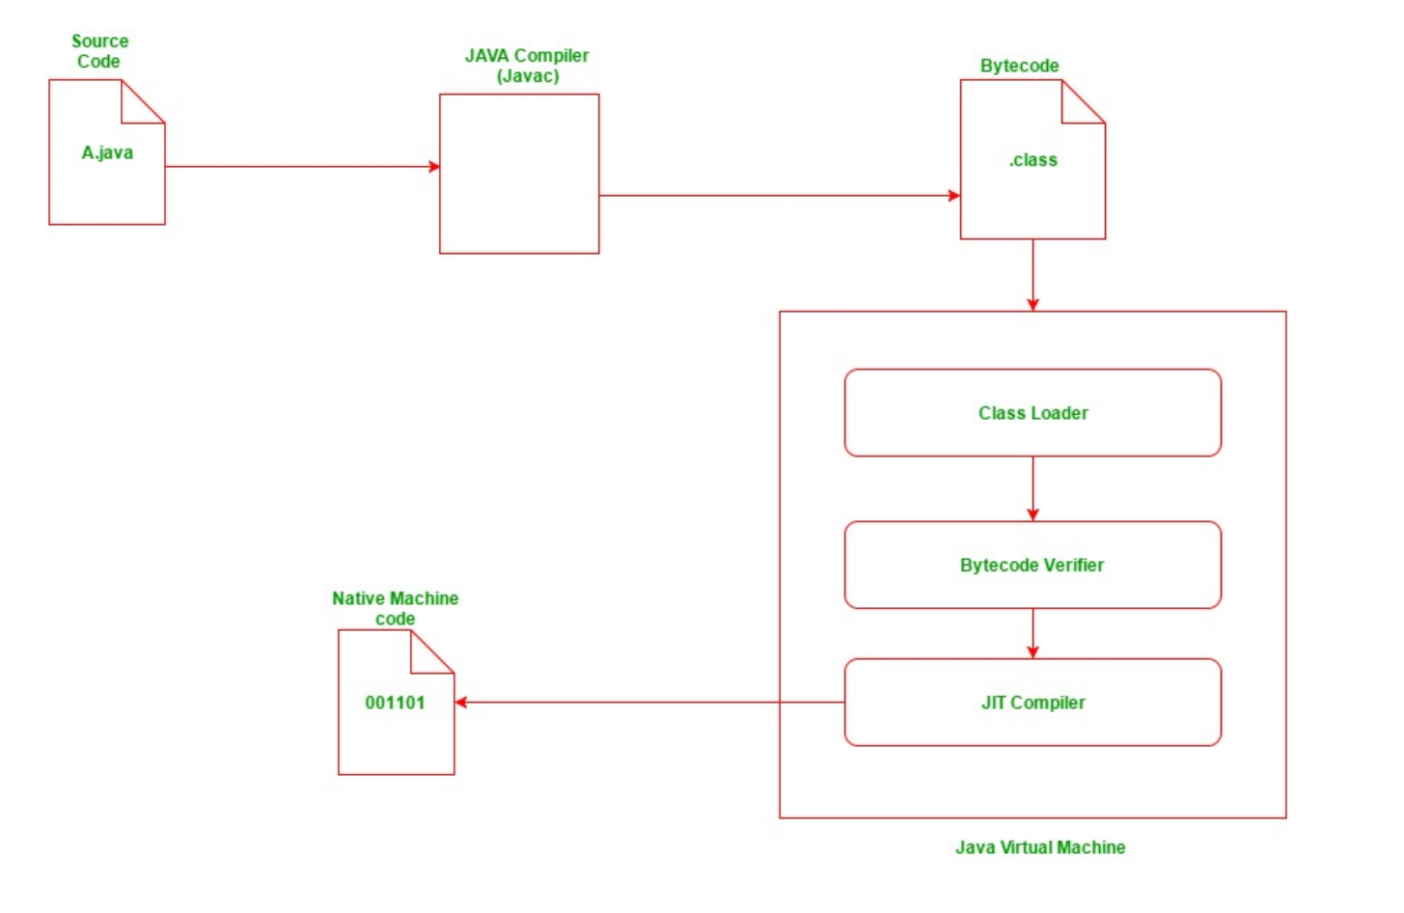

Slide 3
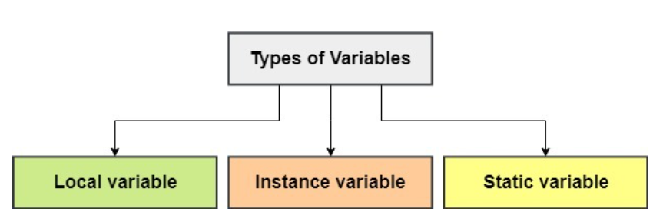
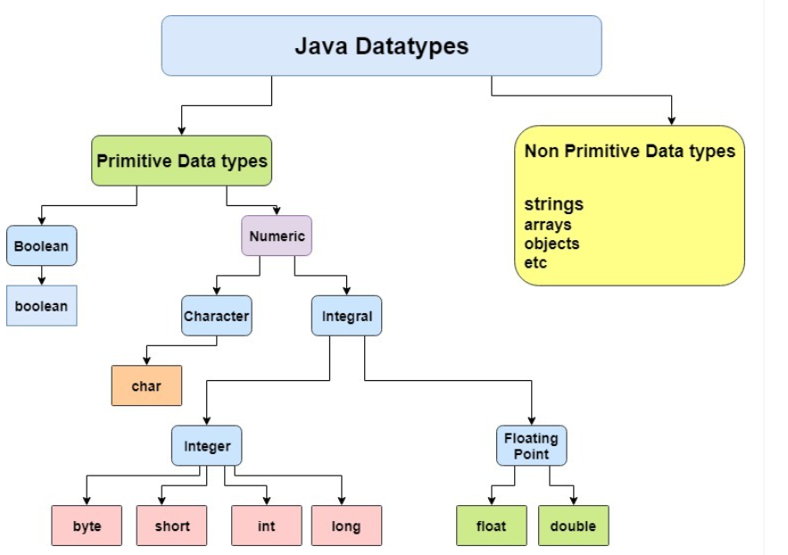
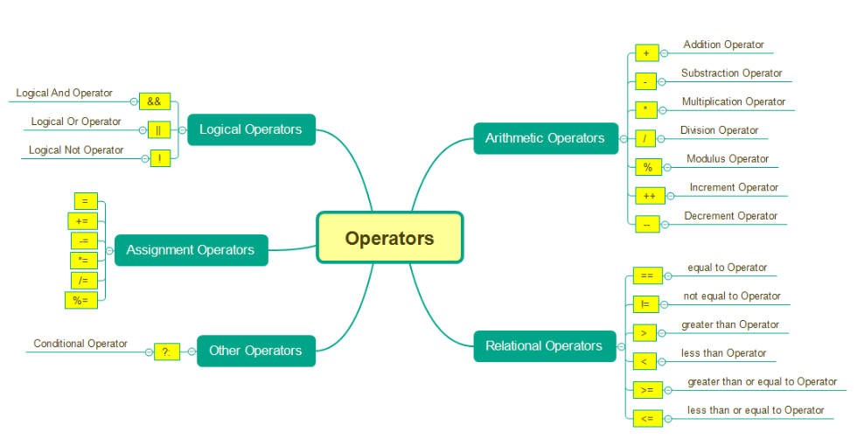
Data Types, Variables and Operators

Slide 4
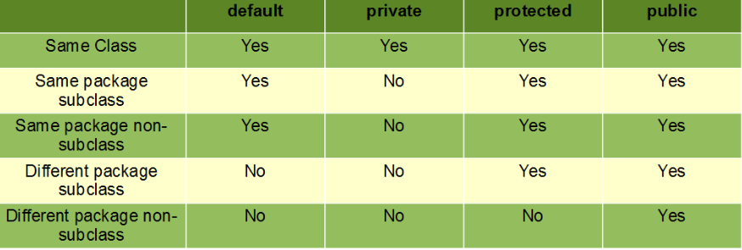
Access Modifiers

Slide 5
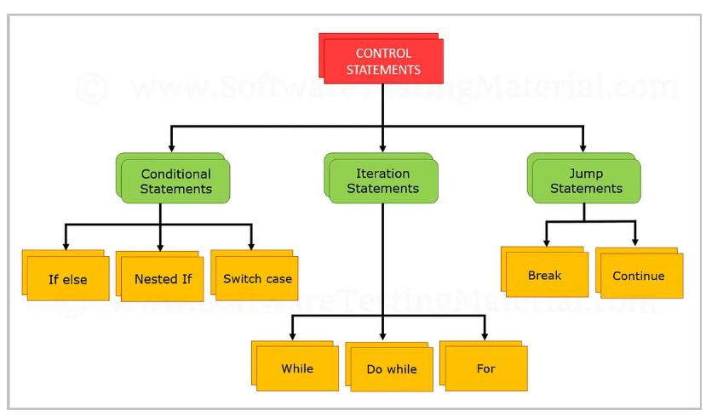
Control Statements

Slide 6
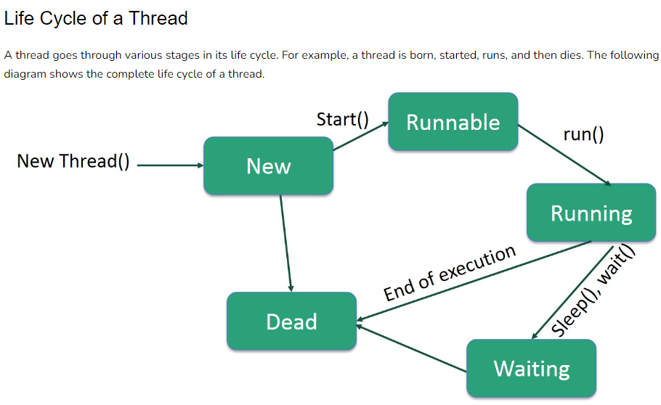
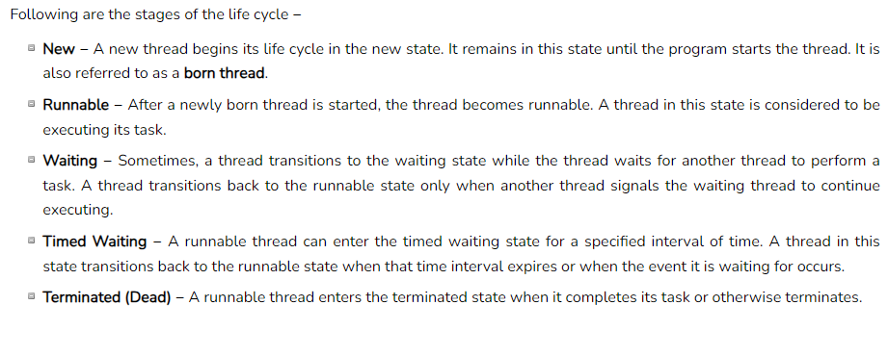
Multithreading

Slide 7
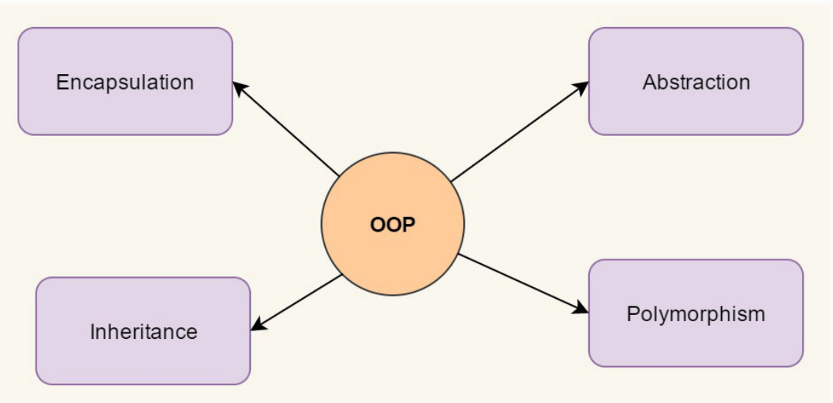
OOPs Concepts

Slide 8
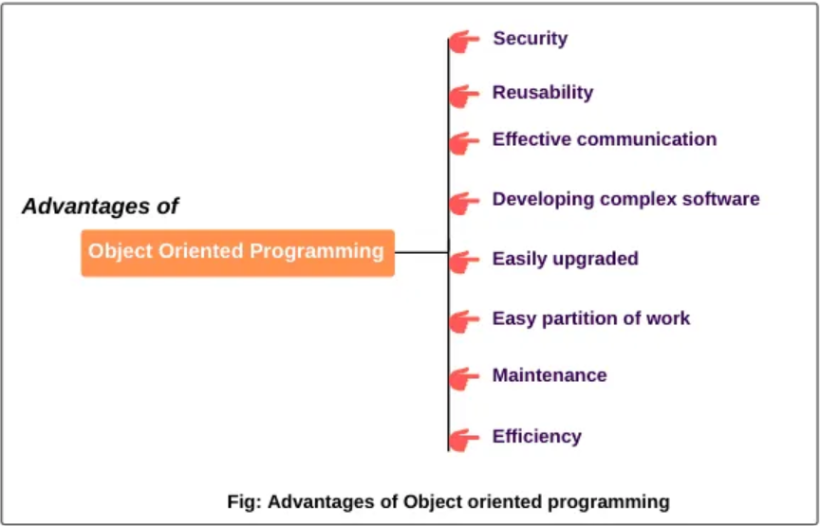
OOPs Benefits

Slide 9
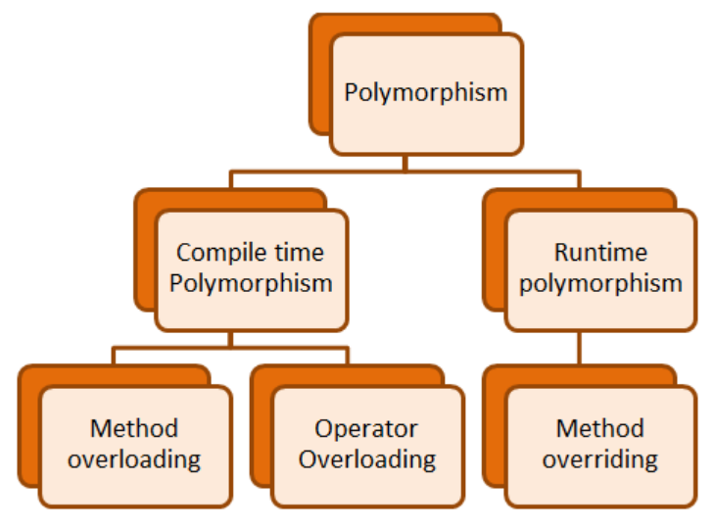
POLYMORPHISM

Slide 10
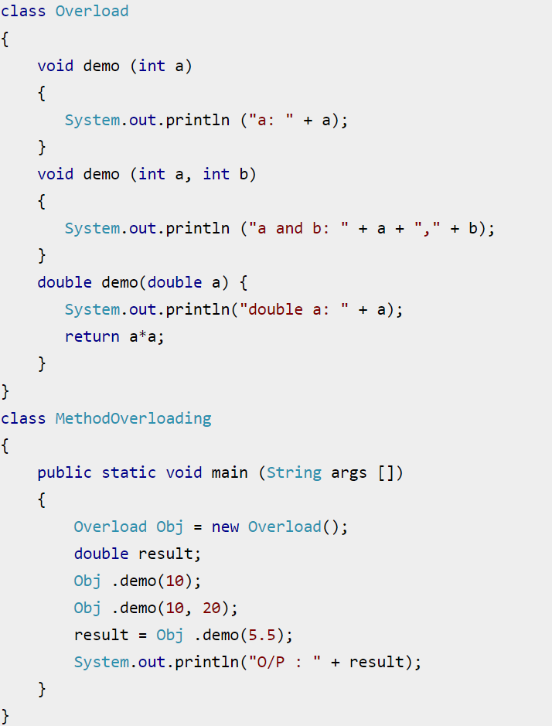
Static Polymorphism(Overload)

Slide 11
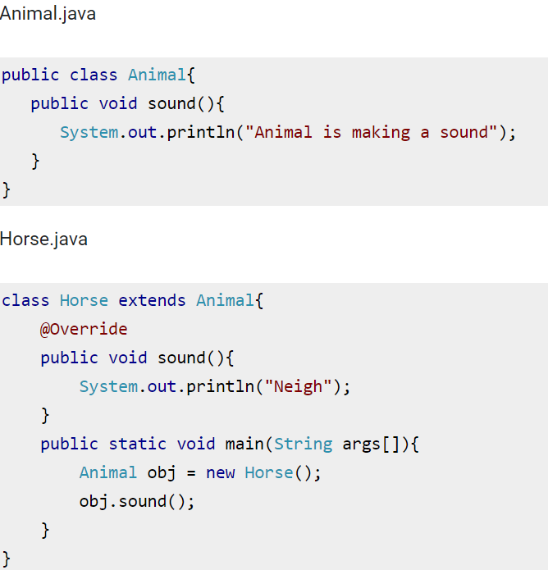
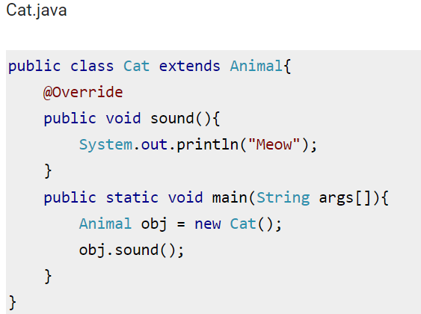
Runtime Polymorphism(Override)

Slide 12
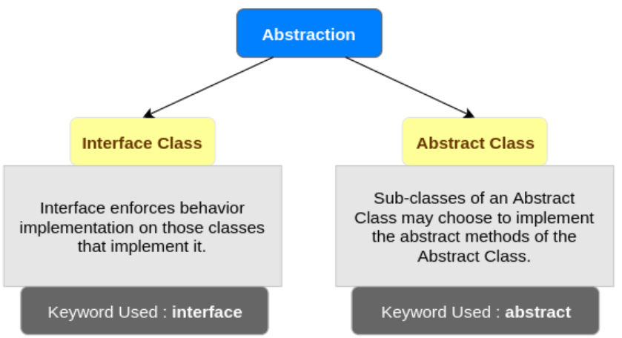
ABSTRACTION

Slide 13
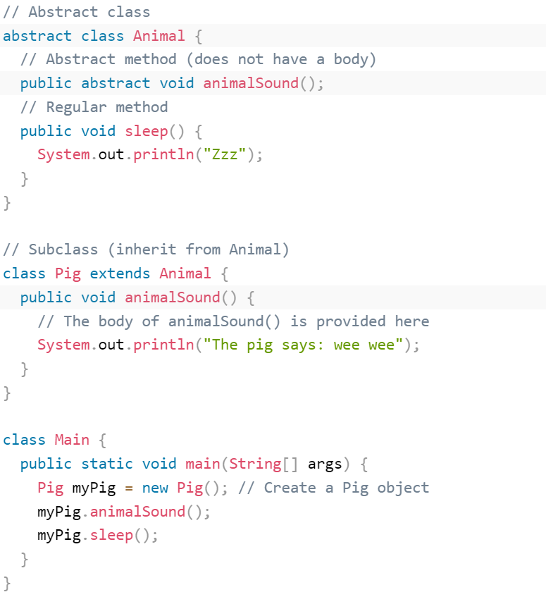
Abstract Class

Slide 14
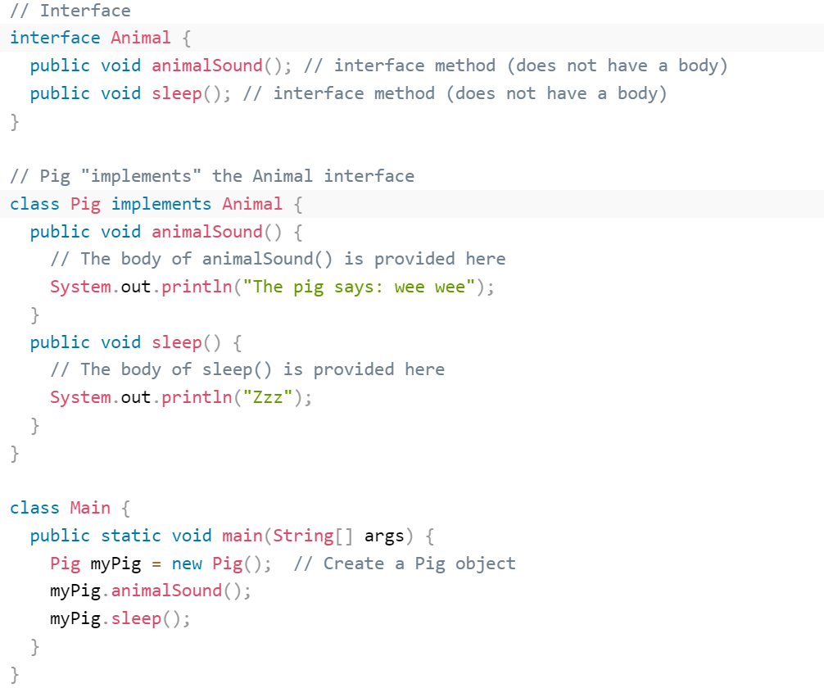
Interface

Slide 15
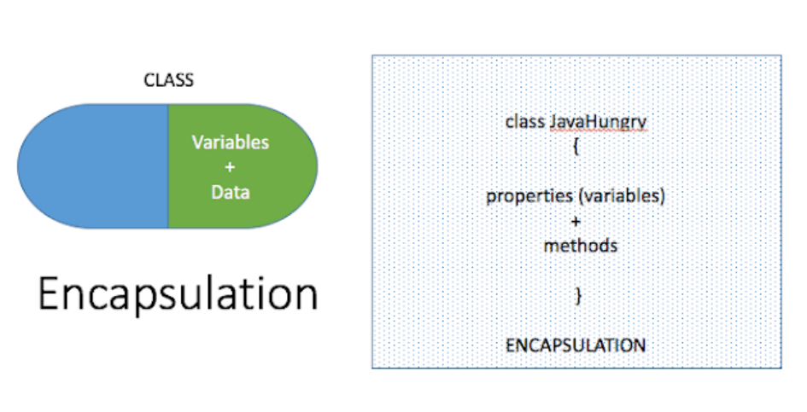
ENCAPSULATION

Slide 16
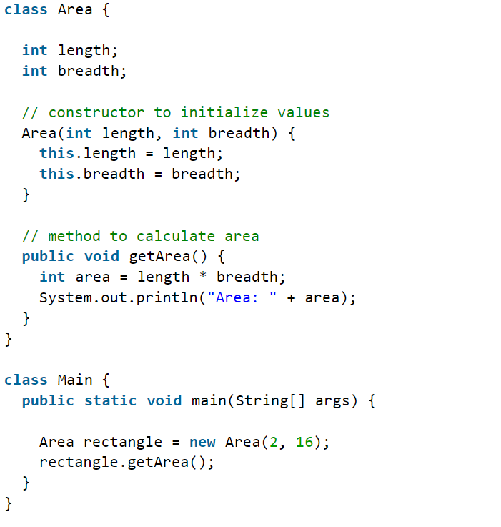
Encapsulation

Slide 17
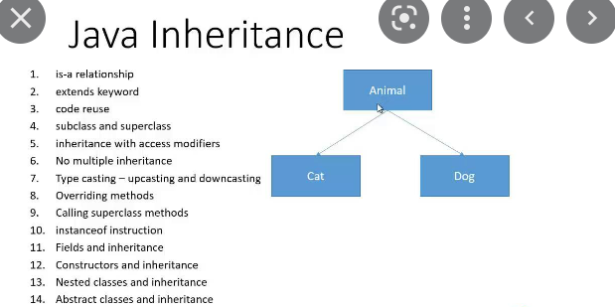
INHERITANCE

Slide 18
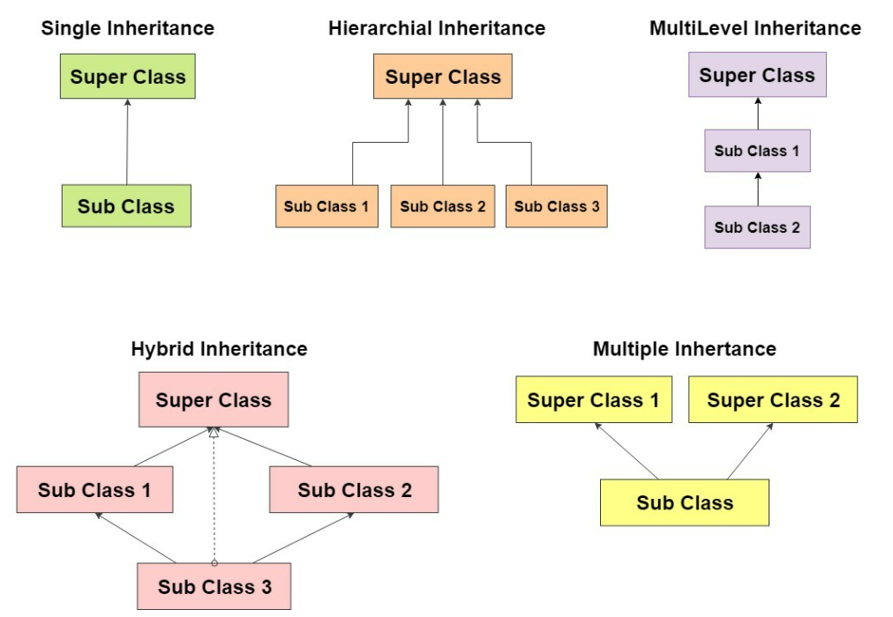
Type of Inheritance

Slide 19
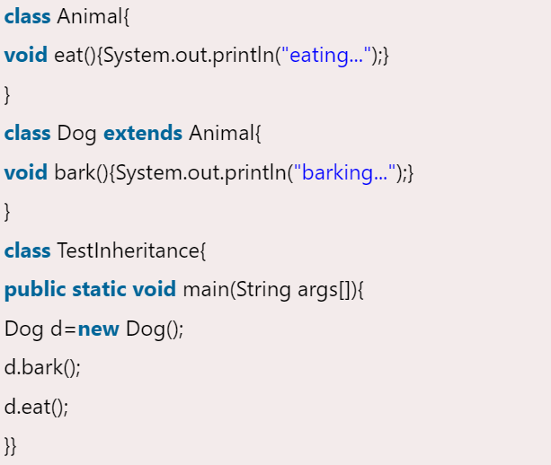
Single Inheritance

Slide 20
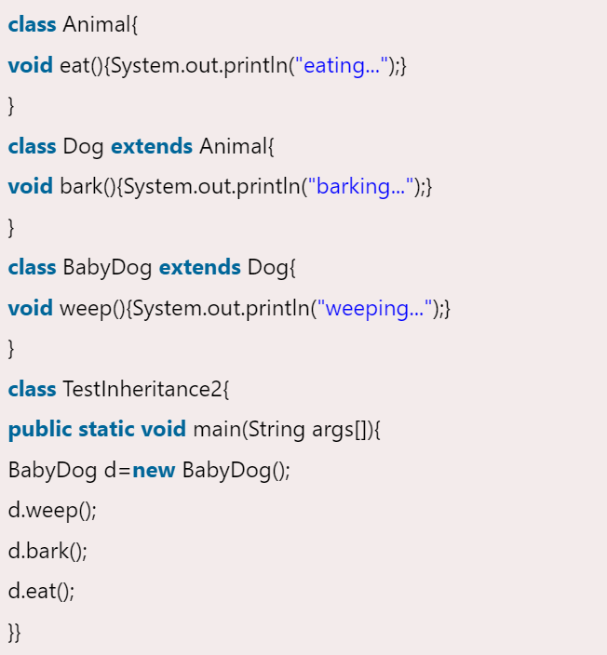
Multi Level Inheritance

Slide 21
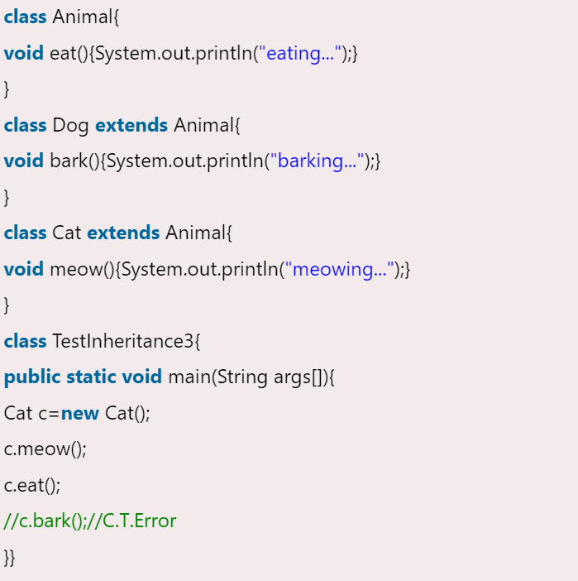
Hierarchical Inheritance

Slide 22
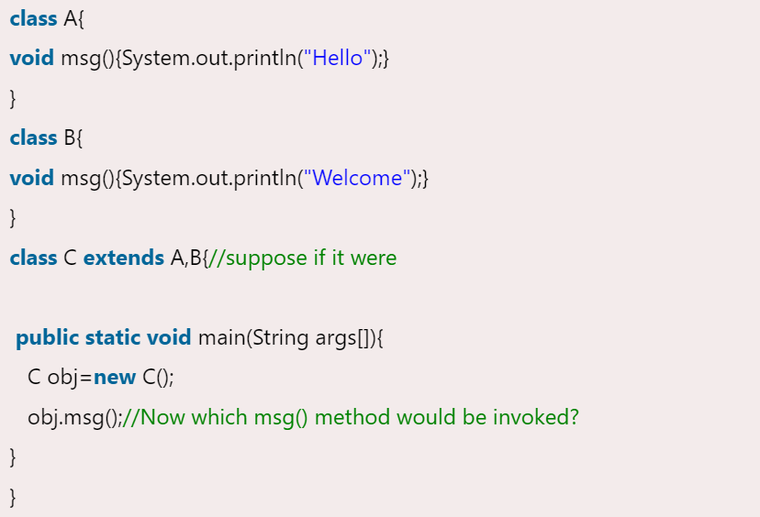
Why Multiple Inheritance not supported in JAVA

Slide 23
PACKAGES
A package is a namespace that organizes a set of related classes and interfaces
Conceptually, like different folders on your computer
Is it necessary to use package in Java?
Java package is used to categorize the classes and interfaces so that they can be easily maintained
Java package provides access protection
Java package removes naming collision

Slide 24
Disadvantages of Packages
We cannot pass parameters to packages.
Change in a function needs to be reflected in all the functions that use the changed function and hence the whole package needs to be recompiled

Slide 25
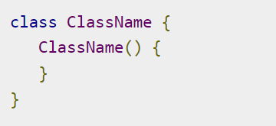
CONSTRUCTORS
A constructor in Java is a special method that is used to initialize objects. The constructor is called when an object of a class is created
Constructors have no explicit return type

Slide 26
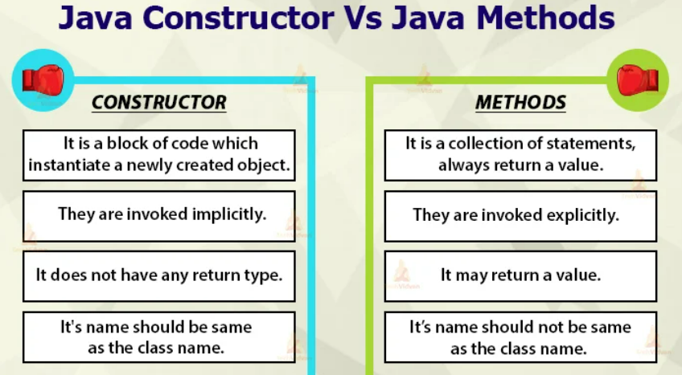

Slide 27
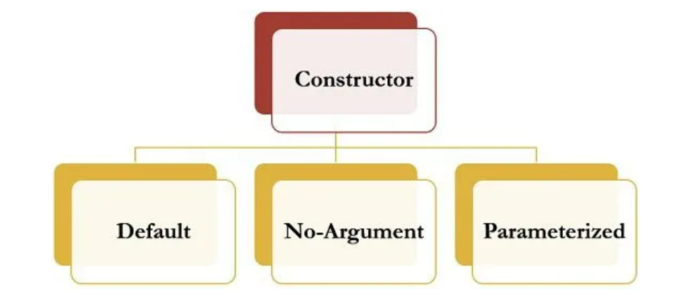
Type of Constructor

Slide 28
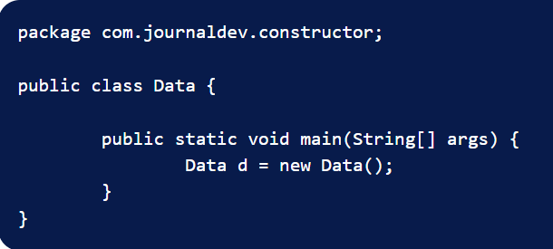
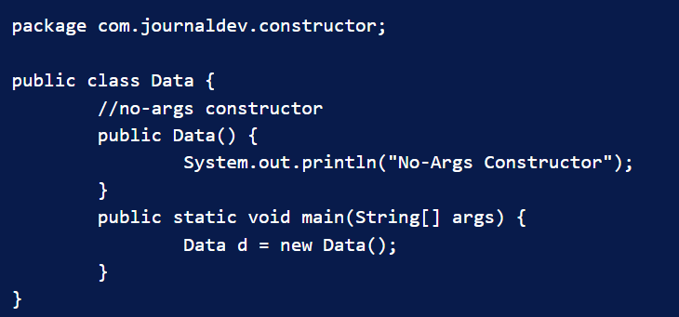
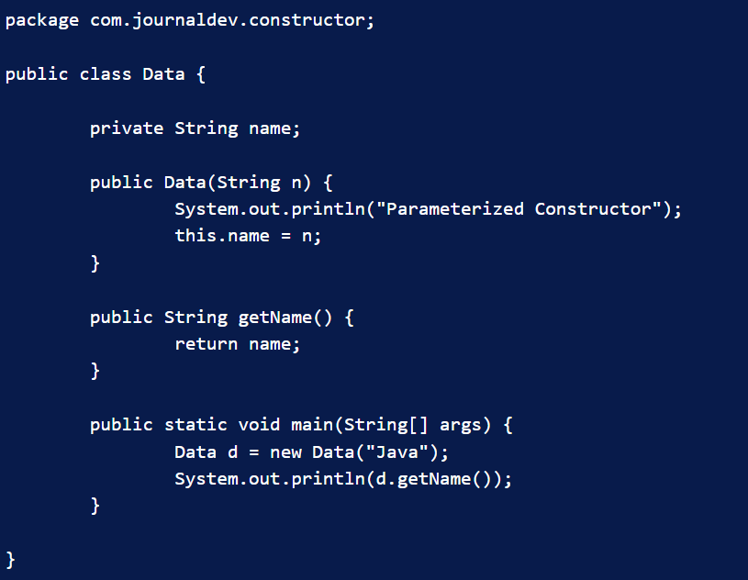
Default Constructor
No-Argument Constructor
Parameterized Constructor

Slide 29
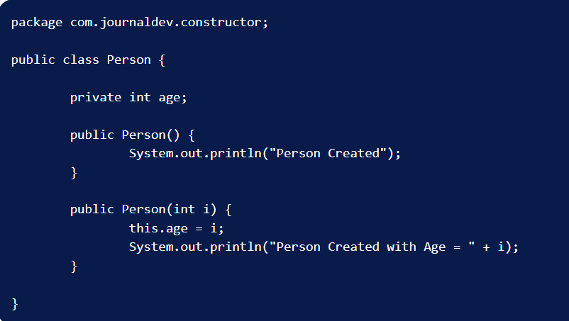
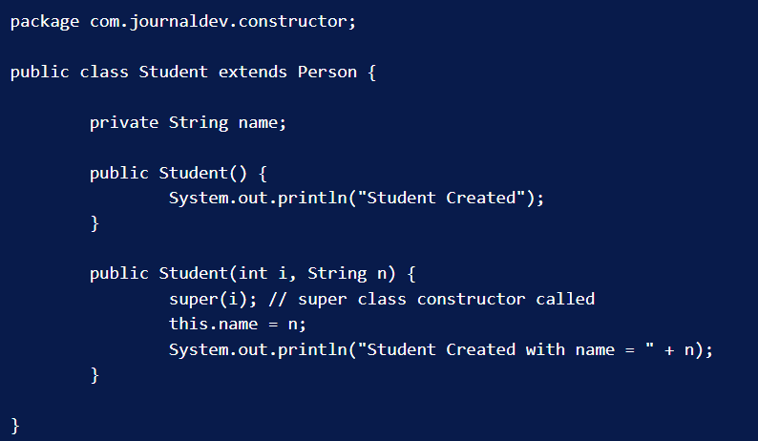
Java Super Constructor

Slide 30
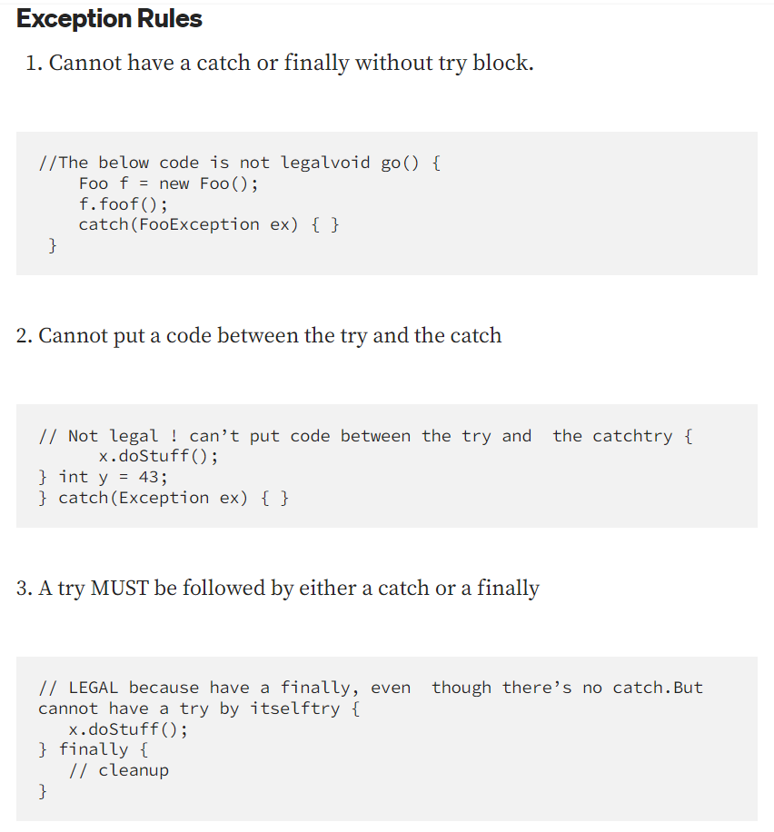
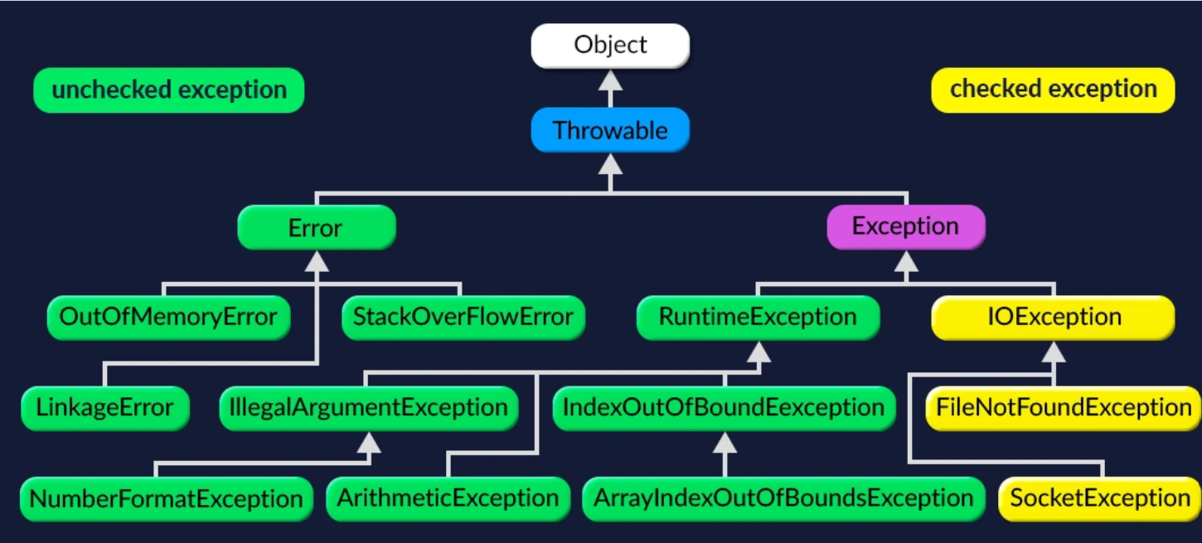
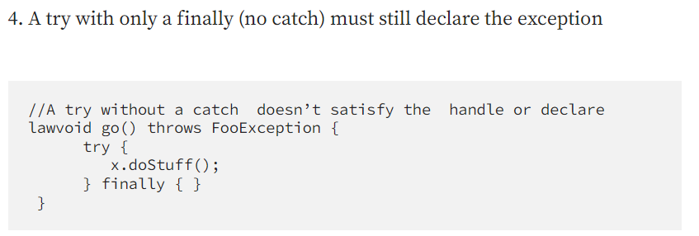
Exception Handling

Slide 31
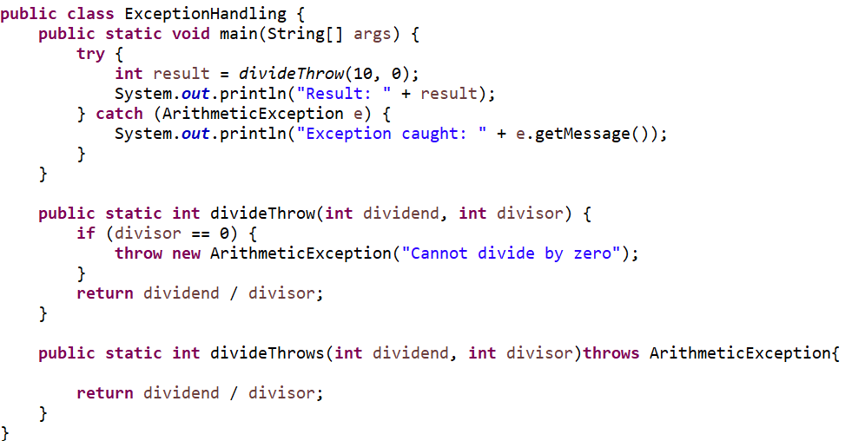
Exception Handling – throw and throws
throw keyword: The throw keyword is used to explicitly throw an exception. It is followed by an instance of an exception class or a subclass of Throwable. When an exception is thrown, the normal flow of the program is disrupted, and the control is transferred to the nearest exception handler that can handle the thrown exception.
throws keyword: The throws keyword is used in the method signature to declare that a method may throw one or more types of exceptions. It is used to indicate that the responsibility of handling the exception is delegated to the caller of the method.

Slide 32
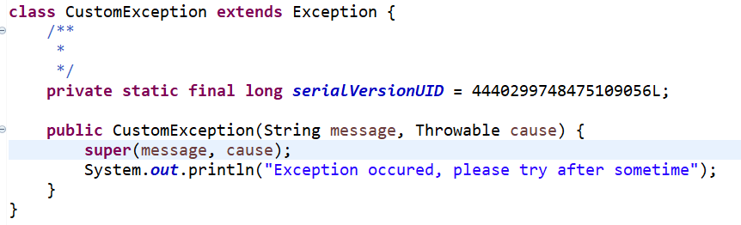
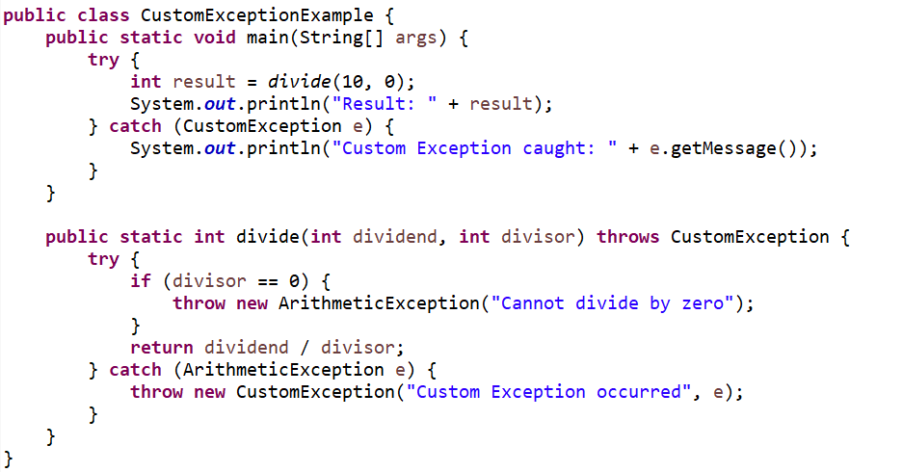
Exception Handling – Custom Exception
In Java, you can create custom exceptions by extending the Exception class or one of its subclasses

Slide 33
COLLECTIONS
Any group of individual objects which are represented as a single unit is known as the collection of the objects.
Before the Collection Framework(or before JDK 1.2) was introduced, the standard methods for grouping Java objects (or collections) were Arrays or Vectors, or Hashtables. All of these collections had no common interface
The implementation of all these collections was defined independently and had no correlation among them
It is very difficult for the users to remember all the different methods, syntax, and constructors present in every collection class

Slide 34
Advantages of the Collection Framework
Consistent API: The API has a basic set of interfaces like Collection, Set, List, or Map, all the classes (ArrayList, LinkedList, Vector, etc.) that implement these interfaces have some common set of methods
Reduces programming effort: A programmer doesn’t have to worry about the design of the Collection but rather he can focus on its best use in his program. Therefore, the basic concept of Object-oriented programming (i.e.) abstraction has been successfully implemented
Increases program speed and quality: Increases performance by providing high-performance implementations of useful data structures and algorithms because in this case, the programmer need not think of the best implementation of a specific data structure. He can simply use the best implementation to drastically boost the performance of his algorithm/program

Slide 35
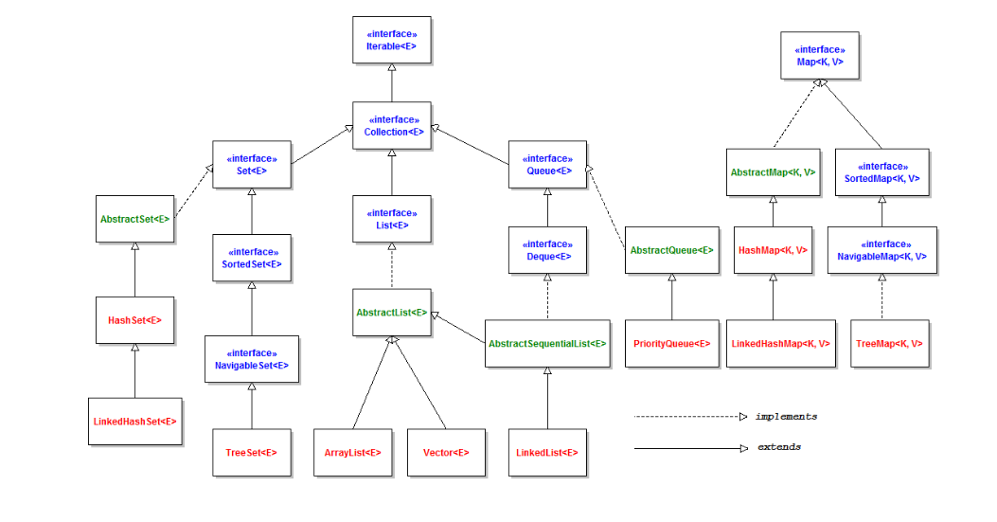
Collection Hierarchy

Slide 36
Collection
Iterable Interface: This is the root interface for the entire collection framework. The collection interface extends the iterable interface. Therefore, inherently, all the interfaces and classes implement this interface. The main functionality of this interface is to provide an iterator for the collections. It returns the Iterator iterator()
Collection Interface: This interface extends the iterable interface and is implemented by all the classes in the collection framework. This interface contains all the basic methods which every collection has like adding the data into the collection, removing the data, clearing the data, etc.
List Interface: This is a child interface of the collection interface. This interface is dedicated to the data of the list type in which we can store all the ordered collection of the objects. This list interface is implemented by various classes like ArrayList, Vector, Stack
List <T> al = new ArrayList<> (); List <T> ll = new LinkedList<> (); List <T> v = new Vector<> ();
Where T is the type of the object
Set Interface: A set is an unordered collection of objects in which duplicate values cannot be stored. This set interface is implemented by various classes like HashSet, TreeSet, LinkedHashSet, etc. Since all the subclasses implement the set, we can instantiate a set object with any of these classes
Set<T> hs = new HashSet<> (); Set<T> lhs = new LinkedHashSet<> (); Set<T> ts = new TreeSet<> ();
Where T is the type of the object

Slide 37
Collection
Map Interface: Map is not considered to be a true collection, as the Map interface does not extend the Collection interface. A map is a data structure that supports the key-value pair mapping for the data. This interface doesn’t support duplicate keys because the same key cannot have multiple mappings. A map is useful if there is data, and we wish to perform operations based on the key. This map interface is implemented by various classes like HashMap, TreeMap, etc.
Map<T> hm = new HashMap<> (); Map<T> tm = new TreeMap<> (); Where T is the type of the object.

Slide 38
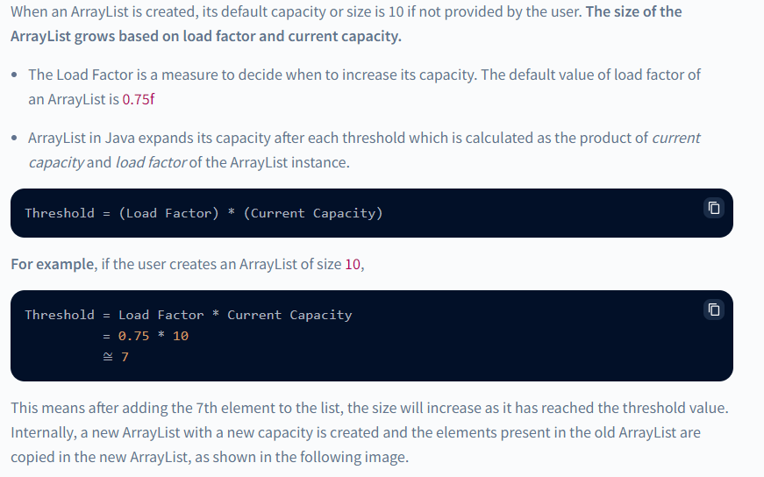
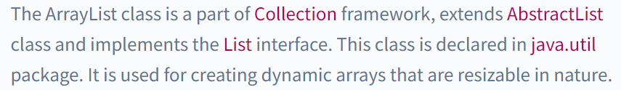
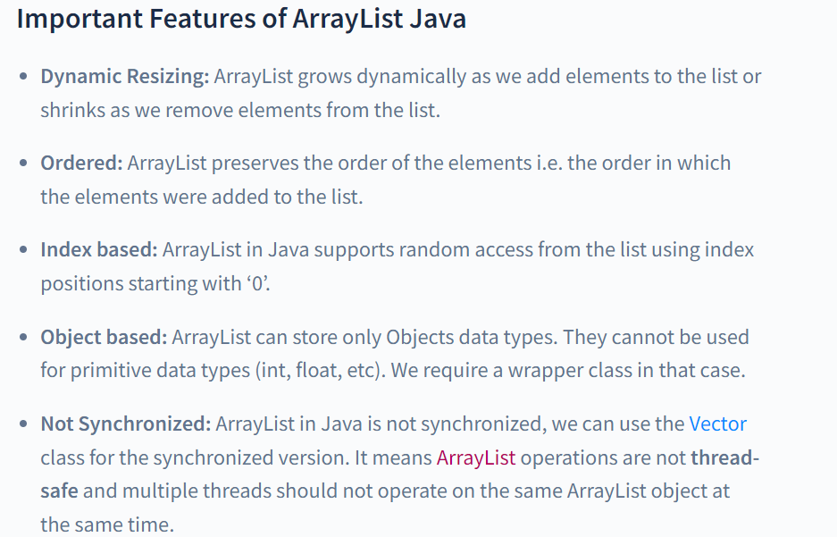
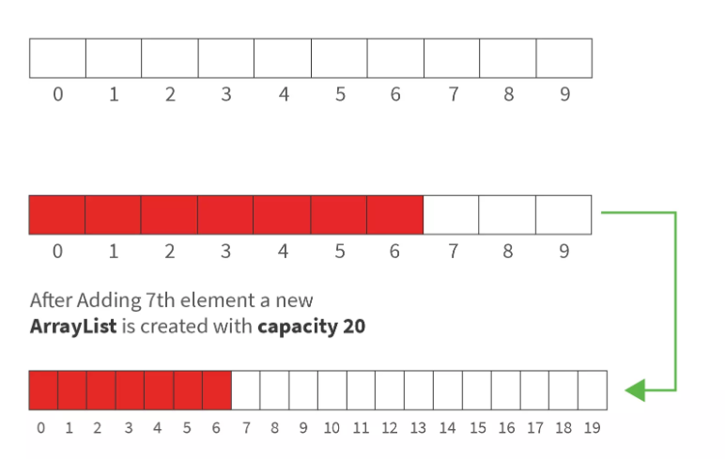
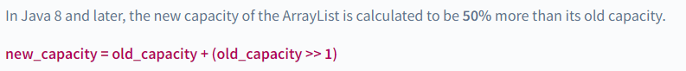
Collection - ArrayList

Slide 39
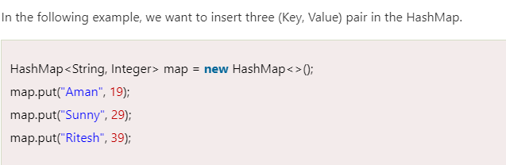
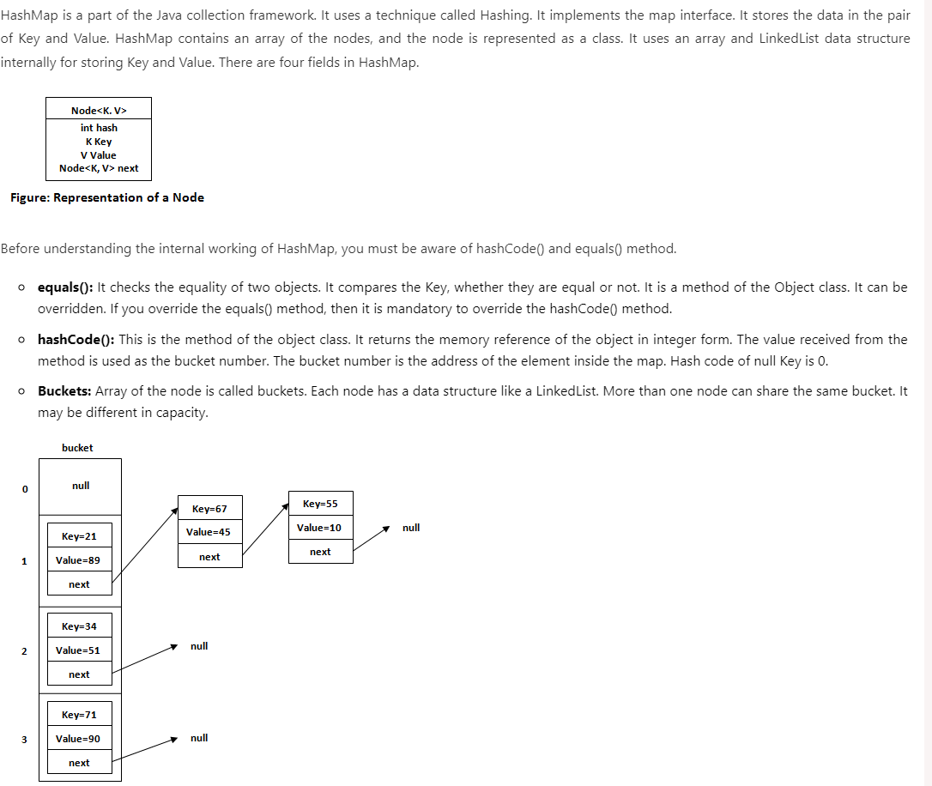
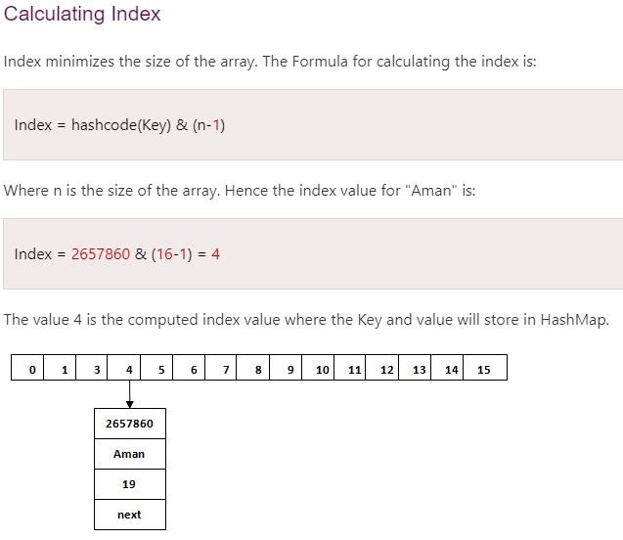
Collection - HashMap

Slide 40
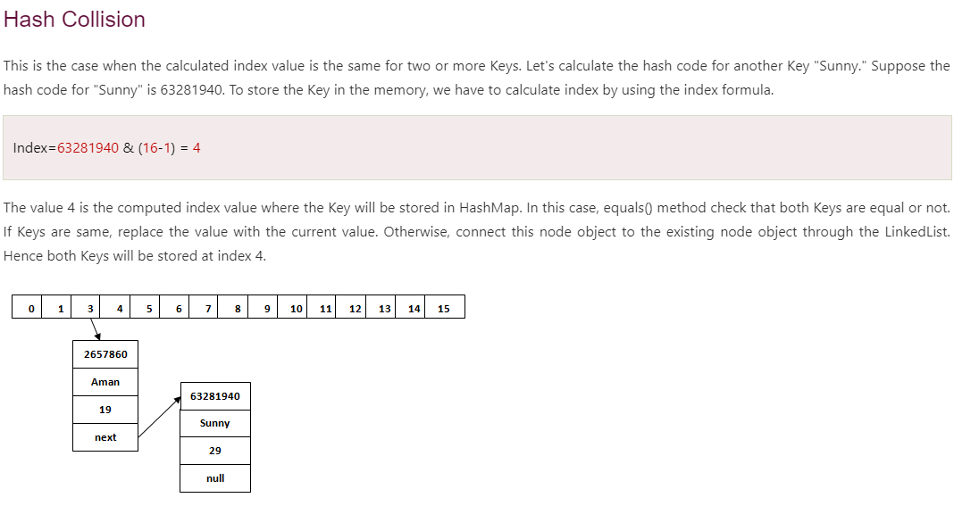
Collection - HashMap

Slide 41
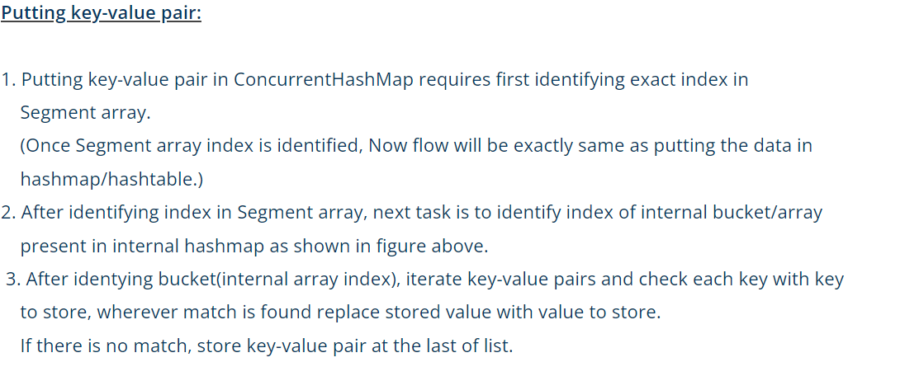


Collection – Concurrent HashMap

Slide 42



Collection – HashSet
No Duplicate Elements: HashSet does not allow duplicate elements. If you try to add an element that already exists in the set, it will be ignored, and the set will remain unchanged.
Unordered Collection: HashSet does not maintain the insertion order of elements. The elements are stored in an unordered manner based on their hash codes, which allows for efficient retrieval and searching.
Efficient Retrieval: HashSet provides constant-time performance for basic operations like add, remove, contains, and size. It achieves this by using a hash table internally, which allows for efficient element retrieval based on their hash codes.
Null Values: HashSet allows the inclusion of null values. You can add a single null value to a HashSet, and it will be treated as a unique element.
Not Thread-Safe: HashSet is not synchronized or thread-safe. If multiple threads access a HashSet concurrently and at least one of them modifies the set, external synchronization is required to ensure thread safety

Slide 43



Generics
JDK 5.0 introduced Java Generics with the aim of reducing bugs and adding an extra layer of abstraction over types
This cast can be annoying — we know that the data type in this list is an Integer. The cast is also cluttering our code. It can cause type-related runtime errors if a programmer makes a mistake with the explicit casting.
It would be much easier if programmers could express their intention to use specific types and the compiler ensured the correctness of such types. This is the core idea behind generics
By adding the diamond operator <> containing the type, we narrow the specialization of this list to only Integer type. In other words, we specify the type held inside the list. The compiler can enforce the type at compile time

Slide 44



Generics - Advantages
JDK 5.0 introduced Java Generics with the aim of reducing bugs and adding an extra layer of abstraction over types.
Type-safety: We can hold only a single type of objects in generics. It
doesn't allow to store other objects.
2. Type casting is not required: There is no need to typecast the object. Before Generics, we need to type cast.
3. Compile-Time Checking: It is checked at compile time so problem will not occur at runtime. The good programming strategy says it is far better to handle the problem at compile time than runtime

Slide 45


Generics
A class that can refer to any type is known as a generic class. Here, we are using the T type parameter to create the generic class of specific type.
Let's see a simple example to create and use the generic class.
The T type indicates that it can refer to any type (like String, Integer, and Employee). The type you specify for the class will be used to store and retrieve the data.

Slide 46


Generics – Type of Parameters
The common type parameters are as follows

Slide 47


ENUM

Slide 48



ENUM

Slide 49

ENUM
Class vs Enum
An enum can, just like a class, have attributes and methods. The only difference is that enum constants are public, static and final (unchangeable - cannot be overridden).An enum cannot be used to create objects, and it cannot extend other classes (but it can implement interfaces).

Slide 50

JAVA 8 Features

Slide 51


Lambda Expression

Slide 52


Functional Interface
An Interface that contains exactly one abstract method is known as functional interface. It can have any number of default, static methods but can contain only one abstract method. It can also declare methods of object class.
Functional Interface is also known as Single Abstract Method Interfaces or SAM Interfaces. It is a new feature in Java, which helps to achieve functional programming approach.
A functional interface can have any number of default methods. Runnable, ActionListener, and Comparable are some of the examples of functional interfaces.
Functional interfaces are interfaces that ensure that they include precisely only one abstract method. Functional interfaces are used and executed by representing the interface with an annotation called @FunctionalInterface
Before Java 8, we had to create anonymous inner class objects or implement these interfaces
Java 8 onwards, we can assign lambda expression to its functional interface object like this

Slide 53


Functional Interface

Slide 54


Functional Interface – Consumer Interface

Slide 55



Functional Interface – Predicate Interface

Slide 56





Functional Interface – Predicate Interface

Slide 57




Optional Class
Optional is a container object used to contain not-null objects. Optional object is used to represent null with absent value. This class has various utility methods to facilitate code to handle values as ‘available’ or ‘not available’ instead of checking null values.
Every Java Programmer is familiar with NullPointerException. It can crash your code. And it is very hard to avoid it without using too many null checks. So, to overcome this, Java 8 has introduced a new class Optional in java.util package. It can help in writing a neat code without using too many null checks. By using Optional, we can specify alternate values to return or alternate code to run. This makes the code more readable because the facts which were hidden are now visible to the developer.

Slide 58


Optional Class
Optional is a container object which may or may not contain a non-null value. You must import java.util package to use this class. If a value is present, isPresent() will return true and get() will return the value. Additional methods that depend on the presence or absence of a contained value are provided, such as orElse() which returns a default value if the value is not present, and ifPresent() which executes a block of code if the value is present. This is a value-based class, i.e., their instances are :
Final and immutable (though may contain references to mutable objects).
Considered equal solely based on equals(), not based on reference equality(==).
Do not have accessible constructors.

Slide 59


Streams API
Basic components involved in Streams:

Slide 60

Streams API

Slide 61



Streams API

Slide 62

Streams API

Slide 63

Streams API

Slide 64

Streams API

